Slide 1
PRINCIPLES OF CONDUCT:
AN UPDATE ON HAZING
J. Jeffry Wahlen
School Board Attorney
Ausley & McMullen Law Firm
425.5471
jwahlen@ausley.com
March 24, 2014

Slide 2
“Coaches have to watch for what they don’t want to see and listen to what they don’t want to hear.”
John Madden
Oakland Raiders Head Coach

Slide 3
Hazing
SCOUTING REPORT:
What Are We Up Against?

Slide 4
Hutchinson, Kansas
HEADLINE:
2 PLEAD GUILTY IN
HIGH SCHOOL FOOTBALL HAZING
February 2014
Four freshman players branded with hot coat hanger
30 days in jail; one year probation

Slide 5
Coventry, Ohio
HEADLINE:
COVENTRY HIGH SCHOOL WRESTLERS CHARGED WITH HAZING
March 2014
Eight first year wrestlers lured into locker room where they were punched, kicked and assaulted with mop handle before a match
Superintendent: “We have great kids in Coventry, and regrettably several of our students got caught up in the moment and went beyond what is acceptable.”

Slide 6
Kenmore, Washington
Headline:
Detectives Investigating High School Hazing
June 2013
Unsanctioned Football Spirit Group Called “Naked Viks” accused of Hazing
Junior James Walvatne said he was blindfolded on Monday night and then brutally beaten. "They used PVC pipes, headless golf clubs, and flour and maple syrup. They peed on us and stuff.”
District Communications Director: "The school has heard rumors in the past, but when investigated, found no evidence. No reports of hazing involving violence have ever been reported.”
Friends of the victims are disappointed the school shut down the Naked Viks for next year. “They shouldn’t have had to go through that and then have them take it away. It got out of hand one year. It’s been a tradition forever”
http://www.kirotv.com/news/news/detectives-investigating-high-school-hazing/nYQFK/

Slide 7
Norwood, Colorado
HEADLINE:
IN COLORADO TOWN, HAZING ATTACK LEAVES VICTIM AN OUTCAST
June 2013
At the state high-school wrestling tournament in Denver, three upperclassmen cornered a 13-year-old boy on an empty school bus, bound him with duct tape and sodomized him with a pencil.
Two of the attackers were sons of the wrestling coach, who was president of the school board. The victim’s father was the K-12 principal.
After the principal reported the incident to police, townspeople forced him to resign. Students protested against the victim at school, put “Go to Hell” stickers on his locker and wore T-shirts that supported the perpetrators. The attackers later pleaded guilty to misdemeanor charges, according to the Denver district attorney’s office.
High-school hazing and bullying used to involve name-calling, towel-snapping and stuffing boys into lockers. Now, boys sexually abusing other boys is part of the ritual. More than 40 high school boys were sodomized with foreign objects by their teammates in over a dozen alleged incidents reported in the past year, compared with about three incidents a decade ago, according to a Bloomberg review of court documents and news accounts.
http://www.bloomberg.com/news/2013-06-20/sodomy-hazing-leaves-13-year-old-victim-outcast-in-colorado-town.html

Slide 8
High School Hazing Incidents
1.5 million high school students are hazed each year.
91% of all high school students belong to at least one group, and half of them, 48% report being subjected to hazing activities.
Both male and female students report high levels of hazing.
Every kind of high school group was involved in hazing including 24% of the students involved in church groups.
79% of the NCAA Athletes report being hazed initially in high school.
Source: Alfred University Study, 1999

Slide 9
Florida
FAMU Marching Band: Robert Champion
Miami Dolphins: Jonathan Martin

Slide 10
Florida Legislature
Senate Bill 1282/House Bill 1117
“Safe Athletics Education and Training Act of 2014”
Prohibits Bullying and Harassment in Sports
Player Pledge
Coach Training
Reporting Procedures
Attorney General to Enforce via Civil Action

Slide 11
GAME PLAN
My Perspective
Review Policies
Anti-Hazing Advice
General Refresher
Final Thoughts

Slide 12
MY PERSPECTIVE
Did Not Play High School Sports
Never Been a Coach or a Teacher
I’m a Parent and a Lawyer
I Have Great Respect for What You Do
I Know a Little Bit About Hazing

Slide 13
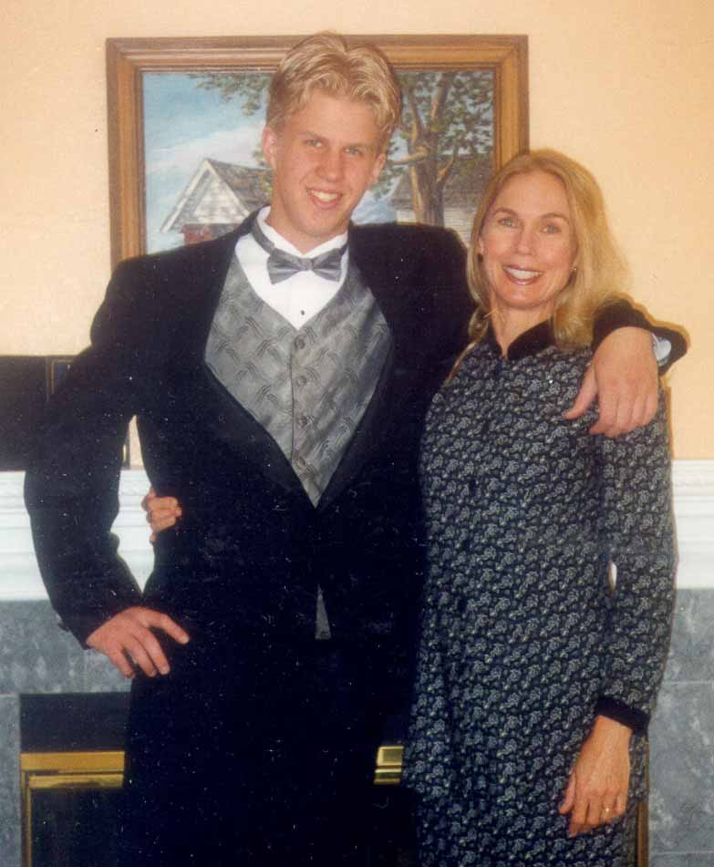
Adrian Heideman
California State University at Chico
October 2000

Slide 14
WHAT I LEARNED
Some Kids Get an Introductory Course on Hazing in Middle and High School
The Line Between Innocent Fun and Trouble is Very Thin
One Bad Apple Spoils the Barrel
Hazing has a Cycle
Public has Lost its Sense of Humor on Hazing

Slide 15
Policy Review
Two Policies
***
LCSB Policy 5516 Student Hazing
State Board Rule 6B-1.006

Slide 16
LCSB Policy 5516 Student Hazing
Hazing activities of any type as a condition for membership and/or participation in a District club or activity or a non-district sponsored club or activity, or for acceptance by any group of students, are inconsistent with and disruptive to the educational process, and prohibited at any time in school facilities, on school property,
and/or off school property if the misconduct is connected to activities or incidents that have occurred on school property.

Slide 17
LCSB Policy 5516 Student Hazing
No administrator, faculty member, or other School Board employee shall encourage, permit, authorize, condone, or tolerate any hazing activities.
No student shall plan, encourage, or engage in any hazing.
No volunteer of the School District shall plan, direct, encourage, aid, condone, or engage in hazing.

Slide 18
LCSB Policy 5516 Student Hazing
Hazing is defined as performing any act or coercing another, including the victim, to perform any act that causes or creates a substantial risk of causing mental or physical harm.

Slide 19
LCSB Policy 5516 Student Hazing
"Hazing" includes, but is not limited to:
Pressuring or coercing the student into violating State or Federal law
Any brutality of a physical nature, such as:
  Whipping, beating, branding
  Exposure to the elements
  Forced consumption of any food, liquor, drug, or other substance
  Other forced physical activity that could adversely affect the physical health or safety of the student

Slide 20
LCSB Policy 5516 Student Hazing
"Hazing" also includes, but is not limited to:
Any activity that would subject the student to extreme mental stress, such as:
  Sleep deprivation
  Forced exclusion from social contact
  Forced conduct that could result in extreme embarrassment
  Other forced activity that could adversely affect the mental health or dignity of the student.

Slide 21
LCSB Policy 5516 Student Hazing
Hazing does not include:
Customary athletic events
Other similar contests or competitions
Any activity or conduct that furthers a legal and legitimate objective.

Slide 22
LCSB Policy 5516 Student Hazing
Key Point
***
Permission, consent, or assumption of risk by an individual subjected to hazing shall not lessen the prohibitions contained in this policy.

Slide 23
LCSB Policy 5516 Student Hazing
Key Point
***
Administrators, faculty members, and other employees of the Board shall be alert particularly to possible situations, circumstances, or events that might include hazing.

Slide 24
LCSB Policy 5516 Student Hazing
Students, administrators, faculty members, and other employees who fail to abide by this policy may be subject to disciplinary action and may be held personally liable for civil and criminal penalties in accordance with law.

Slide 25
LCSB Policy 5516 Student Hazing
Reporting
***
Any person who believes that s/he has been the victim of hazing or any person with knowledge or belief of conduct that may constitute hazing shall report the alleged acts immediately to the Principal or the Superintendent.
Submission of a good faith report of hazing will not affect a person's future employment, grades, or work assignments.

Slide 26
LCSB Policy 5516 Student Hazing
School District Action
***
The Principal or Superintendent will investigate all complaints of hazing and will discipline or take appropriate action against any student, employee, or volunteer of the School District found to have violated this policy.

Slide 27
LCSB Policy 5516 Student Hazing
Retaliation
***
The Principal or Superintendent will discipline any student, employee, or volunteer of the School District who retaliates against any person who makes a good faith report or who testifies or otherwise assists in an investigation, hearing, or other proceeding relating to such hazing. Retaliation includes, but it is not limited to any form of intimidation, reprisal, or harassment.

Slide 28
LCSB Policy 5516 Student Hazing
Key Point
***
Administrators, staff members, and volunteers shall not intentionally remain ignorant of hazing or potential hazing activities.

Slide 29
State Board Rule 6B-1.006
Teacher Duties
***
(3) Obligation to the student requires that the individual:
  (a) Shall make reasonable effort to protect the student from conditions harmful to learning and/or to the student’s mental and/or physical health and/or safety.

Slide 30
State Board Rule 6B-1.006
(e) Shall not intentionally expose a student to unnecessary embarrassment or disparagement.
(f) Shall not intentionally violate or deny a student’s legal rights.
(g) Shall not harass or discriminate against any student on the basis of race, color, religion, sex, age, national or ethnic origin, political beliefs, marital status, handicapping condition, sexual orientation, or social and family background and shall make reasonable effort to assure that each student is protected from harassment or discrimination.

Slide 31
A Thought:
“It’s a little disingenuous to say you can’t coach because you allowed this hazing to take place, but we’re going to let you continue teaching.”
Robert Kelly

Slide 32
ADVICE
DEFENSE FIRST

Slide 33
ANTI-HAZING ADVICE
Set the Tone
  Are Rookies Part of the Team?
  Who Decides Who is Worthy?
Evaluate “Traditions”
Be Visible in Locker Room
Watch the Boneheads
Watch for Potential Victims
Listen – Words Reflect Attitudes
Be Alert – Look for Hazing
Talk to Players who Quit
Report, Report, Report

Slide 34
GENERAL ADVICE
Follow the Rules
Respect Boundaries
Careful with Email and Text messages
Facebook is Not your Friend
No Illegal Use of Hands
Watch your Eyes
Watch your Mouth
Avoid Favoritism

Slide 35
“Just because you're paranoid doesn't mean they aren't after you.”
Joseph Heller, Catch 22

Slide 36
FINAL THOUGHTS

Slide 37
“You must truly care about the lives and welfare of your team members, and demonstrate it with concern and support within a disciplined environment.”
John Wooden
“Good teams become great ones when the members trust each other enough to surrender the ‘me’ for the ‘we’.”
Phil Jackson

Slide 38
“The secret to success is good leadership, and good leadership is all about making the lives of your team members or workers better.”
Tony Dungy

Slide 39
“I think if you want to win, you got to leave that hazing out of the door. It can’t be in your locker room.”
Dez Bryant
Dallas Cowboy receiver

